Slide 1

DealManager™ - The Innovative Operating Platform for Structured Transactions
DealManager™ Overview and Screen Shots

Slide 2
DealManager™ by NorthBound Solutions, Inc.
The DealManager™ suite contains all of the functionality necessary to:
Create compliant Pools of collateral assets using patent-pending algorithms, designed to leverage flexibility and maximize value subject to user-defined and Deal-defined constraints (eligibility and concentration criteria).
Generate configurable Deal reports, including the Servicer Report, Funding Requests, Cash Flow/Hedging models, bond-side models, etc.
Evaluate collateral performance against Deal requirements.
Store all Pool Criteria, user-defined performance tests and Reports.
Retain history of all account-level information, providing a means to incorporate new data points over time.
Benefits of the DealManager™ suite include:
Lower administrative overhead required to comply with Deal requirements.
Reduce the risk of Trigger events through settings that anticipate trends in collateral performance.
Ensure compliance with all Deal-defined selection criteria utilizing a patent-pending technology that only generates compliant pools.
Provide an auditable infrastructure by storing all Deal-related information in a central repository, including collateral information, cash transactions, external data, interest calculations, etc.
Lower the risk of spread sheet errors by storing all approved reporting documents including the Servicer Report, Funding Requests, Cash Flow/Hedging models, bond-side models, etc. in a secure database. Approved modifications and amendments are subsequently loaded and stored in the database, along with comments to document the changes.
Improve control and automation to the unstructured MS Excel-based Servicer Report documents.

Slide 3
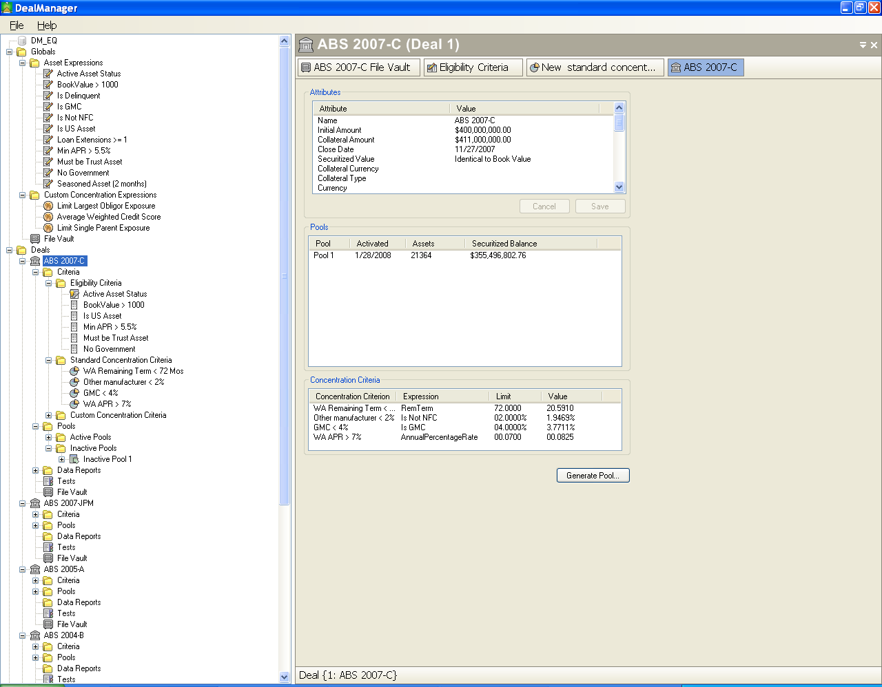
Simplifying the Administrative Complexity
Inputs
DealManager ™ by NBS
Process
Outputs
Asset Servicing Platform(s)
-Asset Values
-Asset History
-Asset Selection Criteria
-Securitization Requirements
-Securitization Reports
-Hedge Statements
-Cash Reporting
-Cash Flow Modeling
Servicer Report
External
Parties
-Trustee
-Investors
-Fiduciaries
Internal
Parties
Management
Decks
Downstream
Analysis
Funding Request
File Vault
Cash Flow Models
External Data Sources
Monthly Deal
Invoice
Hedge Schedule
External Data
Source (ALG)
Bloomberg
SSRS

Slide 4
Introducing DealManager™
DealManager™ utilizes a controlled Reporting platform through the following mechanisms:
File Vault: A document repository designed to store and retain all Deal documentation in a secure manner.
  Formats include: any format is acceptable, including .xls, .doc, .pdf, .txt, .mdb, .rpt
Data Reports: MS Excel based reports designed to automatically use Structured information, including concentration, lists of assets, cash flow summaries, user-defined inputs and other inputs required for the Servicer Report.
  Examples of Data Reports are:
    Servicer Reports
    Funding Statement
    Strat Reports
    Cash Flow forecasts and models
    Other portfolio analysis models
Additional Reports that can be customized by the user for:
  Portfolio Analysis
  Trend Analysis
  Management and Investor Reporting

Slide 5
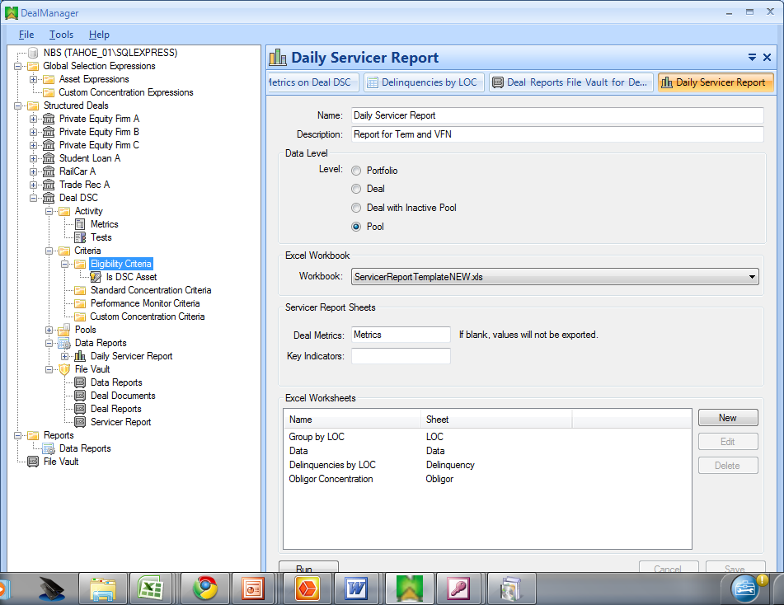
DealManager™ Overview
Global Expressions are custom calculations and true/false conditions defined by the user to characterize the collateral portfolio.
These calculations and conditions are applied to the appropriate Deal(s) to reflect the Eligibility Criteria and Concentration Criteria for each Securitization Deal.
The Deals section contains information about the Securitization Deal, as well as information about the various criteria defined by the users to create Securitization pools.
This section also shows a history of criteria used to create each Securitization Pool over time. “Active Pools” represent assets that have already been “sold” into the Deal while “Inactive Pools” represent collection of compliant assets under evaluating for “sale” in the current period.
“Deal Metrics” captures and stores select results from the Servicer Report, such as collateral activity, Liability amortization, Trigger performance and Waterfall calculations from the Servicer Report
“Data Reports” are extracts configured by the user to export Asset data from the DealManager™ database into a pre-defined Excel workbook. Once in the workbook, the user can use the data in models, reports and to create the Servicer Report.
“File Vault” stores electronic documents in a secure database and is the source for all Data Reports. This repository represents the primary source for retaining all Securitization Deal information.

Slide 6
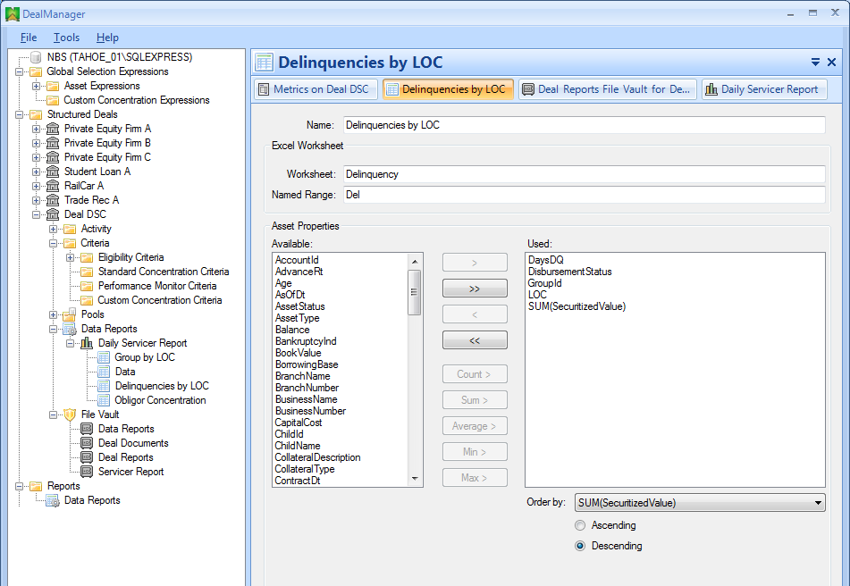
Generate User-Defined Reports – MS Excel
“Data Reports” are used to automatically load MS Excel workbooks stored in the File Vault with Securitization information from the DealManager database.
Users define through DealManager the fields, the target Worksheet location, the name of the data range as well as whether the values should be summary or a list.
The type of information is:
  Asset information
  Cash Transaction information
  Inputs information
Examples of Data Reports are:
  Servicer Report
  Cash Flow / Hedging Models
  Any MS Excel Model for Securitization Analysis

Slide 7

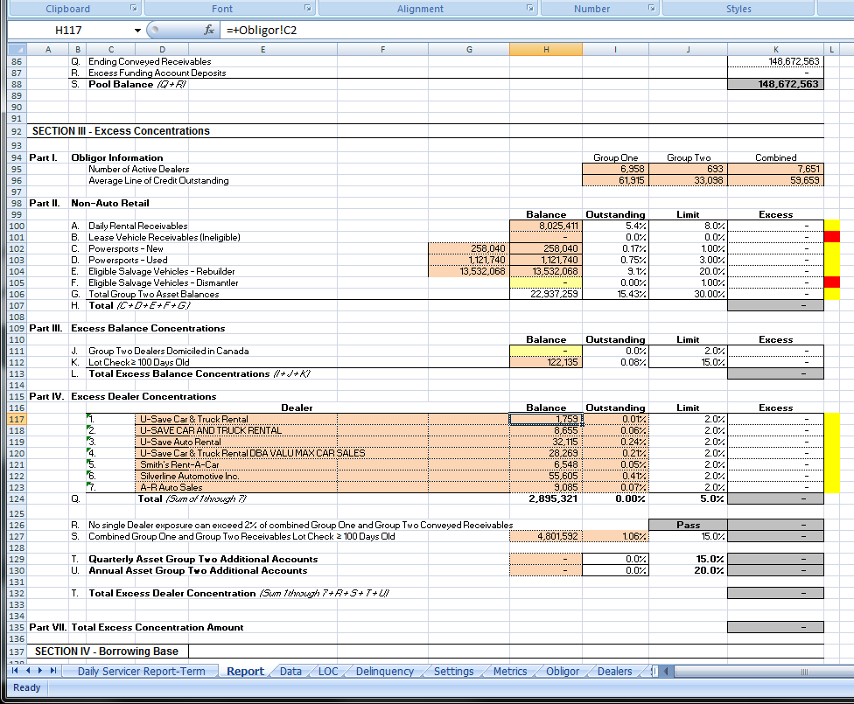
Servicer Report Process
When a Data Report, like the Daily Servicer Report, is run, all defined data is exported from DealManager database into MS Excel.
The same template is used, however MS Excel lookup formulas are used to run calculations instead of dependency on Pivot Tables and 80K rows of data.
The “final” Servicer Report is generated as a new, values-only file. This file only includes the actual report worksheet (typically).
Defined values are also extracted from the Servicer Report and loaded into the DealManager DB.

Slide 8
About NorthBound Solutions, Inc.
NorthBound Solutions, Inc. (NBS) has been providing innovative consulting and software solutions to the Financial Services industry since 2001.
NBS combines its core strengths in acquiring, organizing and presenting data with deep domain expertise to deliver solutions that address strategic, operational and managerial needs of its clients.
The domain expertise of NBS lies principally in the areas of Asset-Backed Securitization and Structured Finance, Business Intelligence Strategy, Process and Implementation, Accounting Compliance, Regulatory Capital, Treasury and Executive Management Reporting.
Website: www.northboundsolutions.com
Email: info@northboundsolutions.com

Slide 9
Contact NorthBound Solutions, Inc.
Jonathan Kingsepp, Principal
jont@northboundsolutions.com
Jon Peterson, Architect
jon@northboundsolutions.com
NorthBound Solutions, Inc.
118 N. Clinton St.
Suite 100-7
Chicago, IL 60661
(312) 985-6090
www.northboundsolutions.com

